Slide 1
Overview of the Marine Ecosystems Research Programme
Marine Ecosystems Research Programme
www.marine-ecosystems.org.uk | marine.ecosystems@pml.ac.uk | +44 (0)1752 633167
Project and Knowledge Exchange Office hosted by Plymouth Marine Laboratory
Funded by the Natural Environment Research Council and the Department for Environment, Food and Rural Affairs

Slide 2
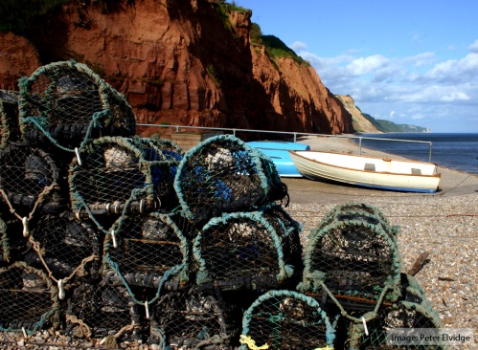
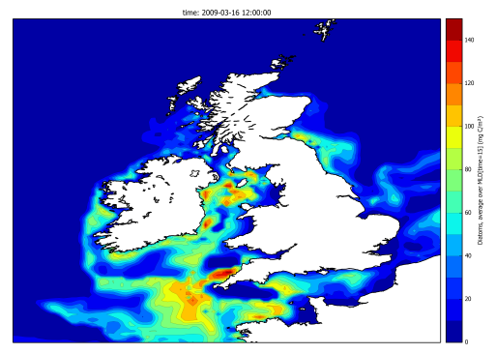
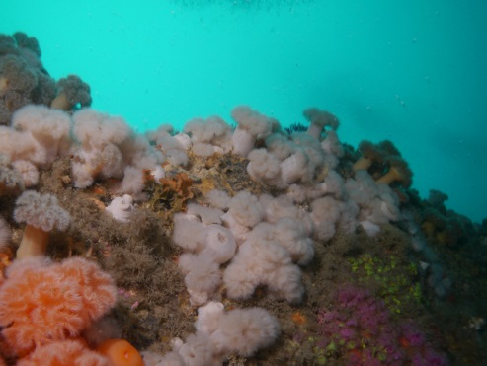
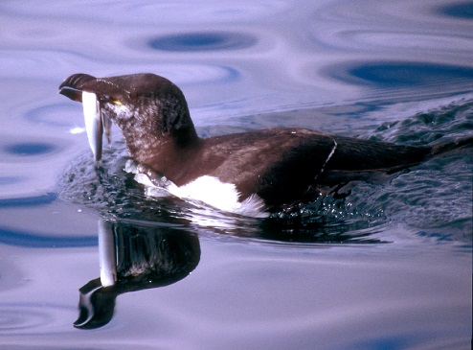
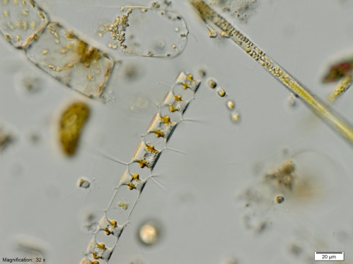
Aim
Integrating existing data and targeted new data with current models and knowledge of ecosystem services,
in order to improve our understanding of the
whole UK marine ecosystem

Slide 3
Overview
£5m, 5 year research programme
Funded by the Natural Environment Research Council (NERC) and the Department for Environment, Food and Rural Affairs (Defra)
Addressing key knowledge gaps in marine ecosystem research
Involving over 50 UK scientists from 12 research organisation

Slide 4
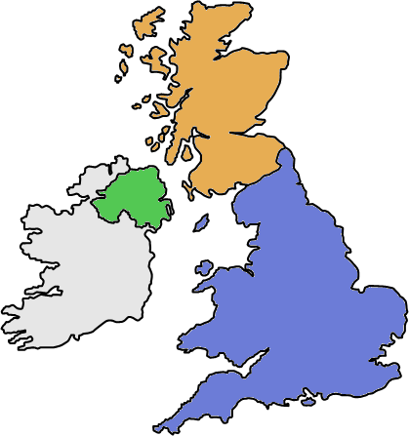
MERP Consortium
Marine
Scotland
£450k
University
of Glasgow
£225k
£225k
£75k
£600k
AFBI
£480k
NOC-POL
£75k
MERP Consortia
Broad and appropriate range of skills
United by ‘large-scale thinking’ and a multidisciplinary approach
Blend of early- and mid-to-later-career researchers
£450k
£225k
DEFRA
£110k
£580k
£~990k
Incl. SAHFOS

Slide 5
Programme Structure
System to bring together and analyse diverse data
Macro-ecological analysis of large-scale long-term patterns
Build model ensemble with appropriate HTL/ES models
Estimate effects of BU/TD effects on Ecosystem Services
WP3
Trade-offs between services
Further development of the ERSEM modelling system
We are here
Year 1
Year 2
Year 3
Year 4
Year 5
Bottom-up and top-down (BU/TD) effects in models
Experiments / observations to fill gaps in knowledge relevant to models
Development of the ERSEM modelling system to improve BD/ES links
System to predict ES consequences of management actions
WP3
Cumulative impacts and thresholds

Slide 6
Policy areas addressed
MERP will develop a suite of marine ecosystem models and provide vital evidence, tools and advice to support the:
Development and implementation of the Marine Strategy Framework Directive (MSFD)
Marine and Coastal Access Act
Marine (Scotland) Act
Common Fisheries Policy
OSPAR Joint Assessment and Monitoring Programme

Slide 7
Integration through MERP brings together scientists across the UK
Scientists with different areas of expertise working together
Employing a range of modelling approaches
Bringing together empiricists, modellers and ecosystem services researchers
Merging data from various sources for novel analyses
Ensemble modelling to understand certainty of predictions
Focusing new data collection to develop and improve models
Linking ecosystem state and process understanding to services
Linking new understanding to relevant policies

Slide 8
Ecosystem services
MERP will investigate impacts of natural and human pressures on marine ecosystems, to help forecast changes in ecosystem services. The National Ecosystem Assessment (2011) approach is being followed and will focus on:
Food provision
Biological checks and balances
Leisure and recreation
Bioremediation of waste

Slide 9
Additional funding
In 2017 two new projects were funding to extended the activities of MERP
Project 1: Understanding trade-offs to maximise the benefits from living marine natural capital Lead by Mike Heath, University of Strathclyde.
Project 2: Cumulative Impacts and the Management of Marine Ecosystems (MERP Module 8) Led by Tom Webb, University of Sheffield.

Slide 10
Contacts
Programme Office
Co-ordinators: Paul Somerfield (pjso@pml.ac.uk), Icarus Allen (jia@pml.ac.uk)
Programme Officer: Jessica Heard (jessh@pml.ac.uk)
Knowledge Exchange: Kelly-Marie Davidson (kdav@pml.ac.uk)
Funders
NERC Programme Manager: Jessica Surma (jetc@nerc.ac.uk)
Alternatively, please contact Defra’s Marine Evidence Team (marinescience@defra.gsi.gov.uk)

